Slide 1
The global carbon cycle
Silvia Caldararu
Email: caldaras@tcd.ie

Slide 2

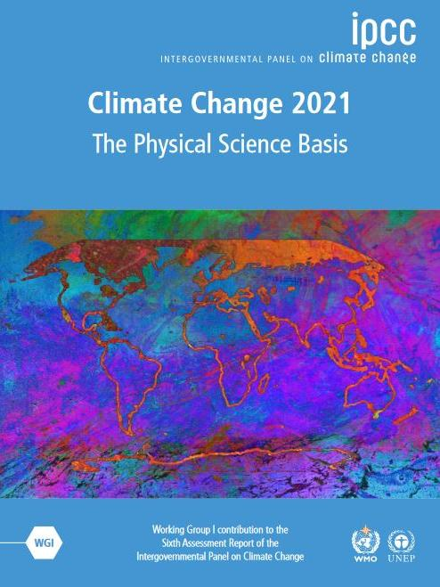
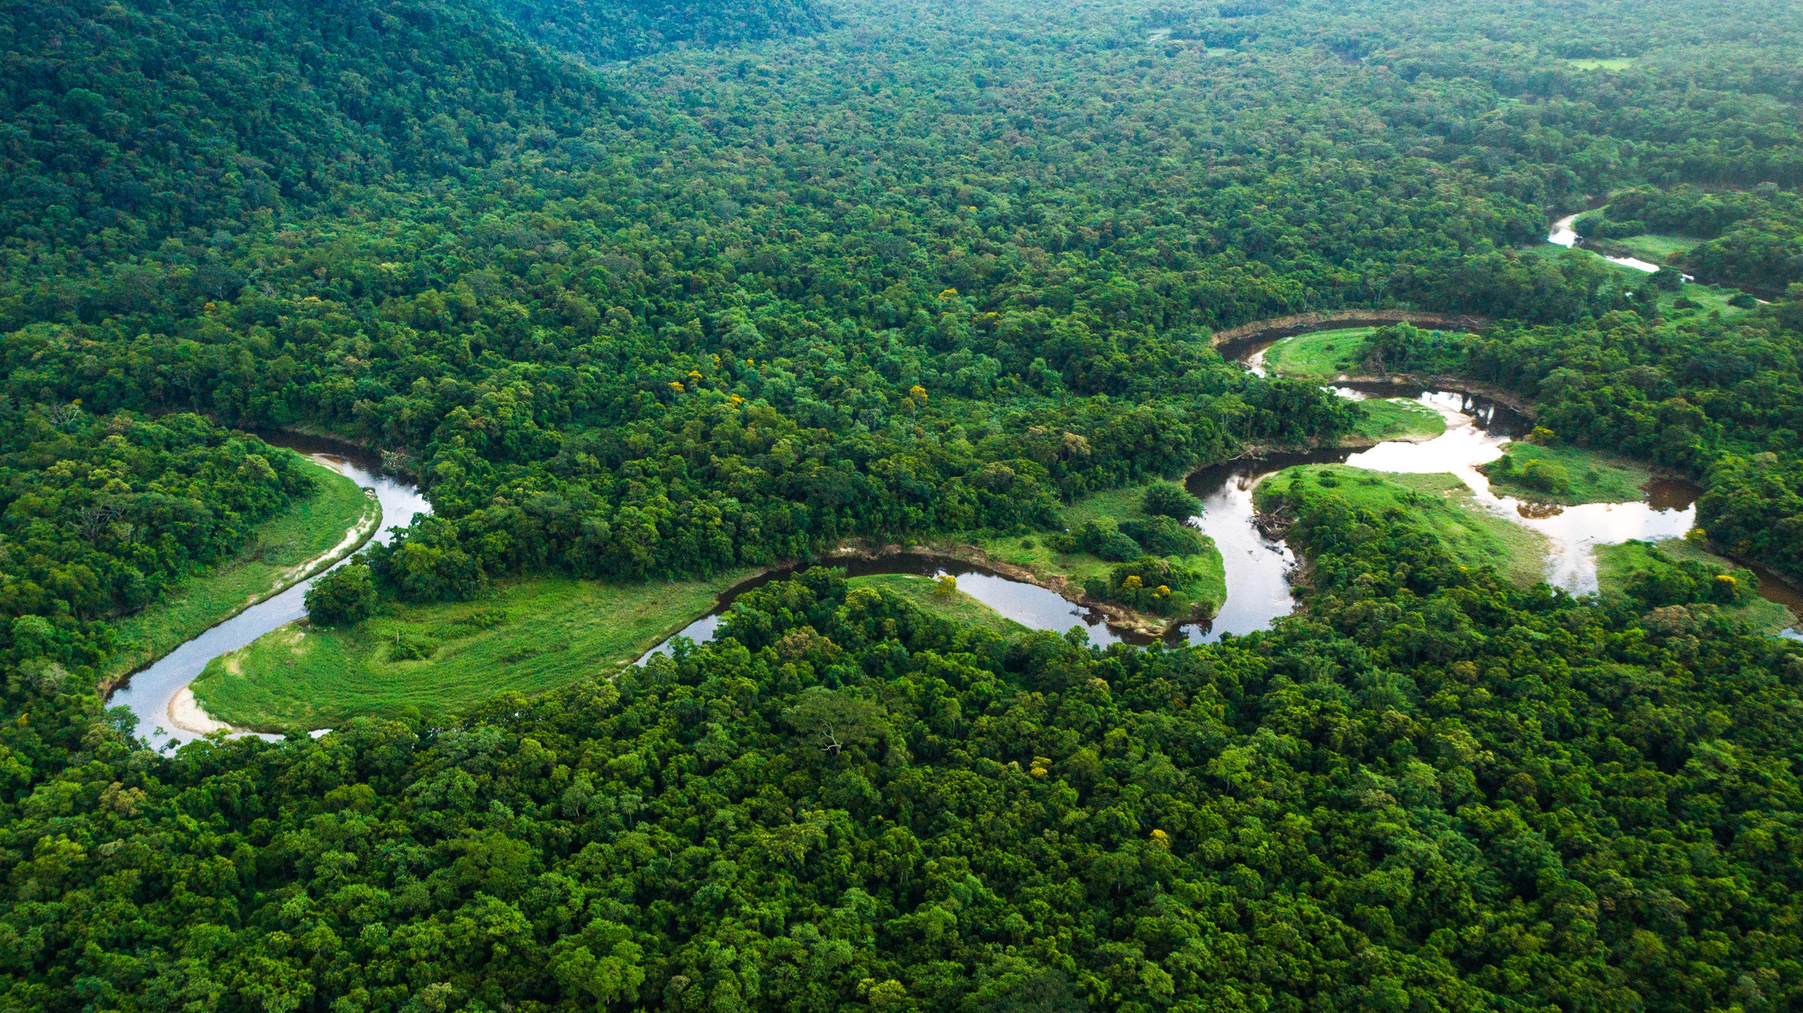

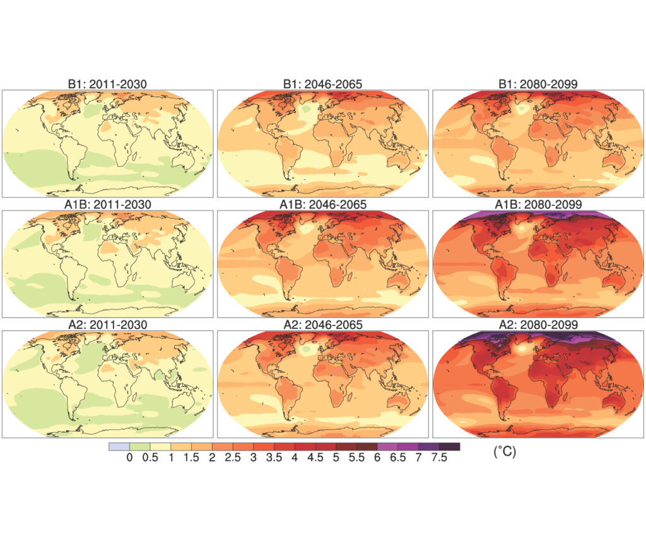
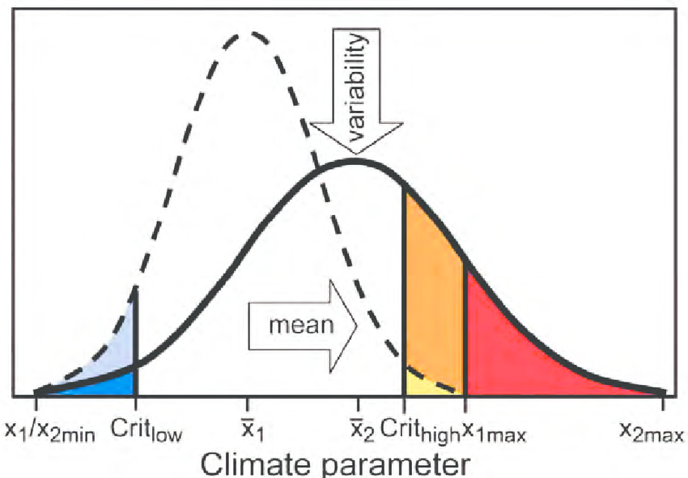
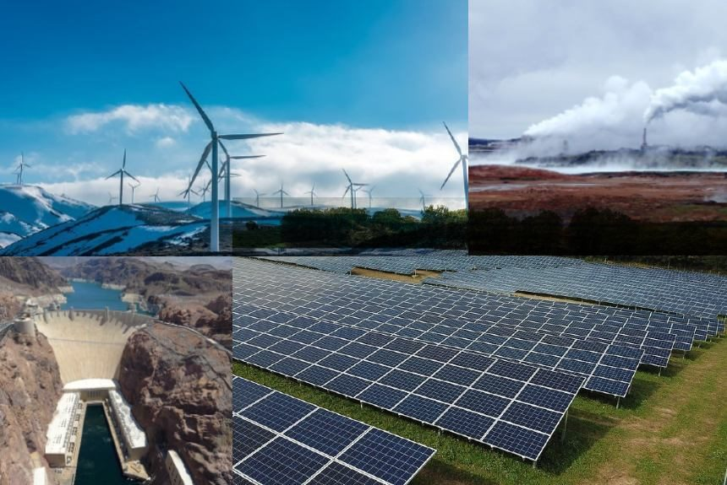
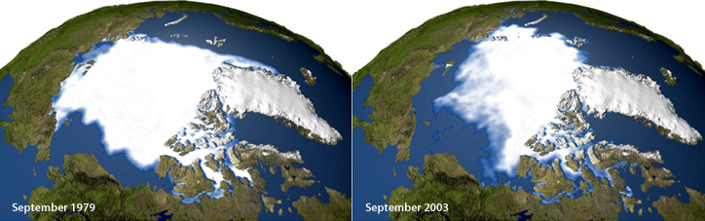
Atmosphere
Climate fundamentals
Predicting climate
Atmosphere
Global C cycle
IPCC report
Earth system models
Climate impacts
Climate solutions
Extreme events
Tipping points
Sea ice, ice caps,
Energy
Mitigation
Nature-based solutions

Slide 3
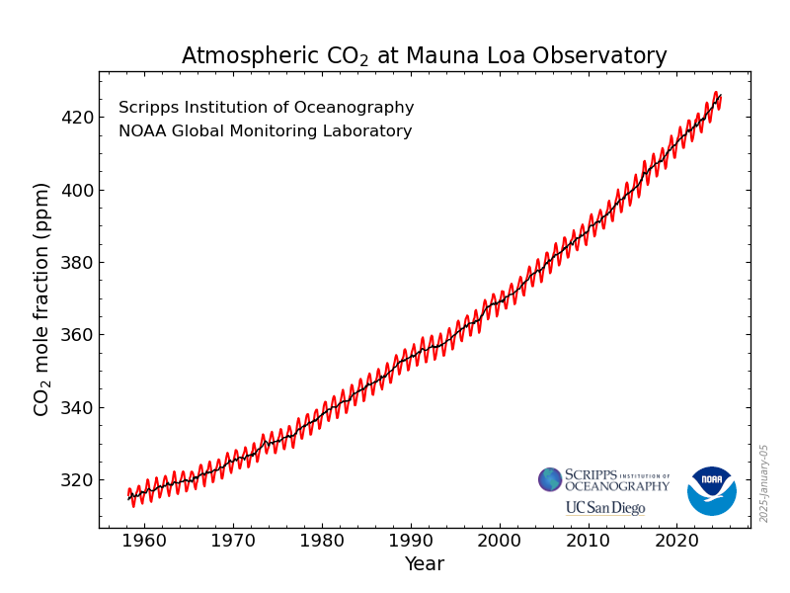

Slide 4
Useful concepts: pools and fluxes
Pool: mass of carbon in a given Earth system component
(gC )
Flux: transfer of carbon compounds between pools
(gC /m2/day)

Slide 5
Useful concepts: sinks and sources
A pool is a sink of carbon if there is a flux of carbon from the atmosphere into it
A pool is a source of carbon if there is a flux of carbon from it to the atmosphere

Slide 6
Useful concepts: sinks and sources
A pool is a net sink of carbon if the total flux of carbon from the atmosphere into it
A pool is a net source of carbon if there is the total flux of carbon from it to the atmosphere

Slide 7
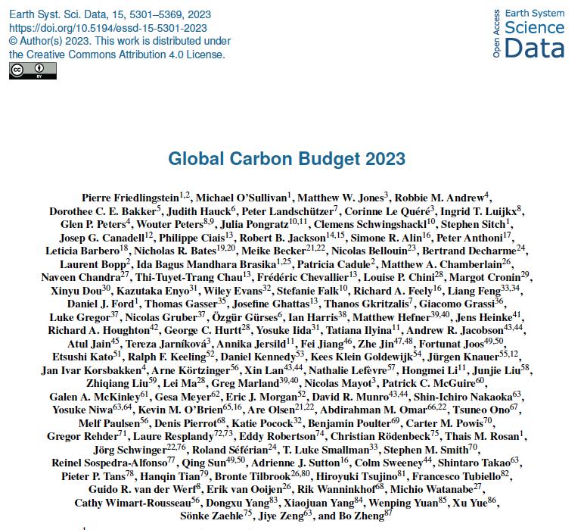
Notes:
Global Carbon Budget 2023 https://essd.copernicus.org/articles/15/5301/2023/essd-15-5301-2023.html

Slide 8
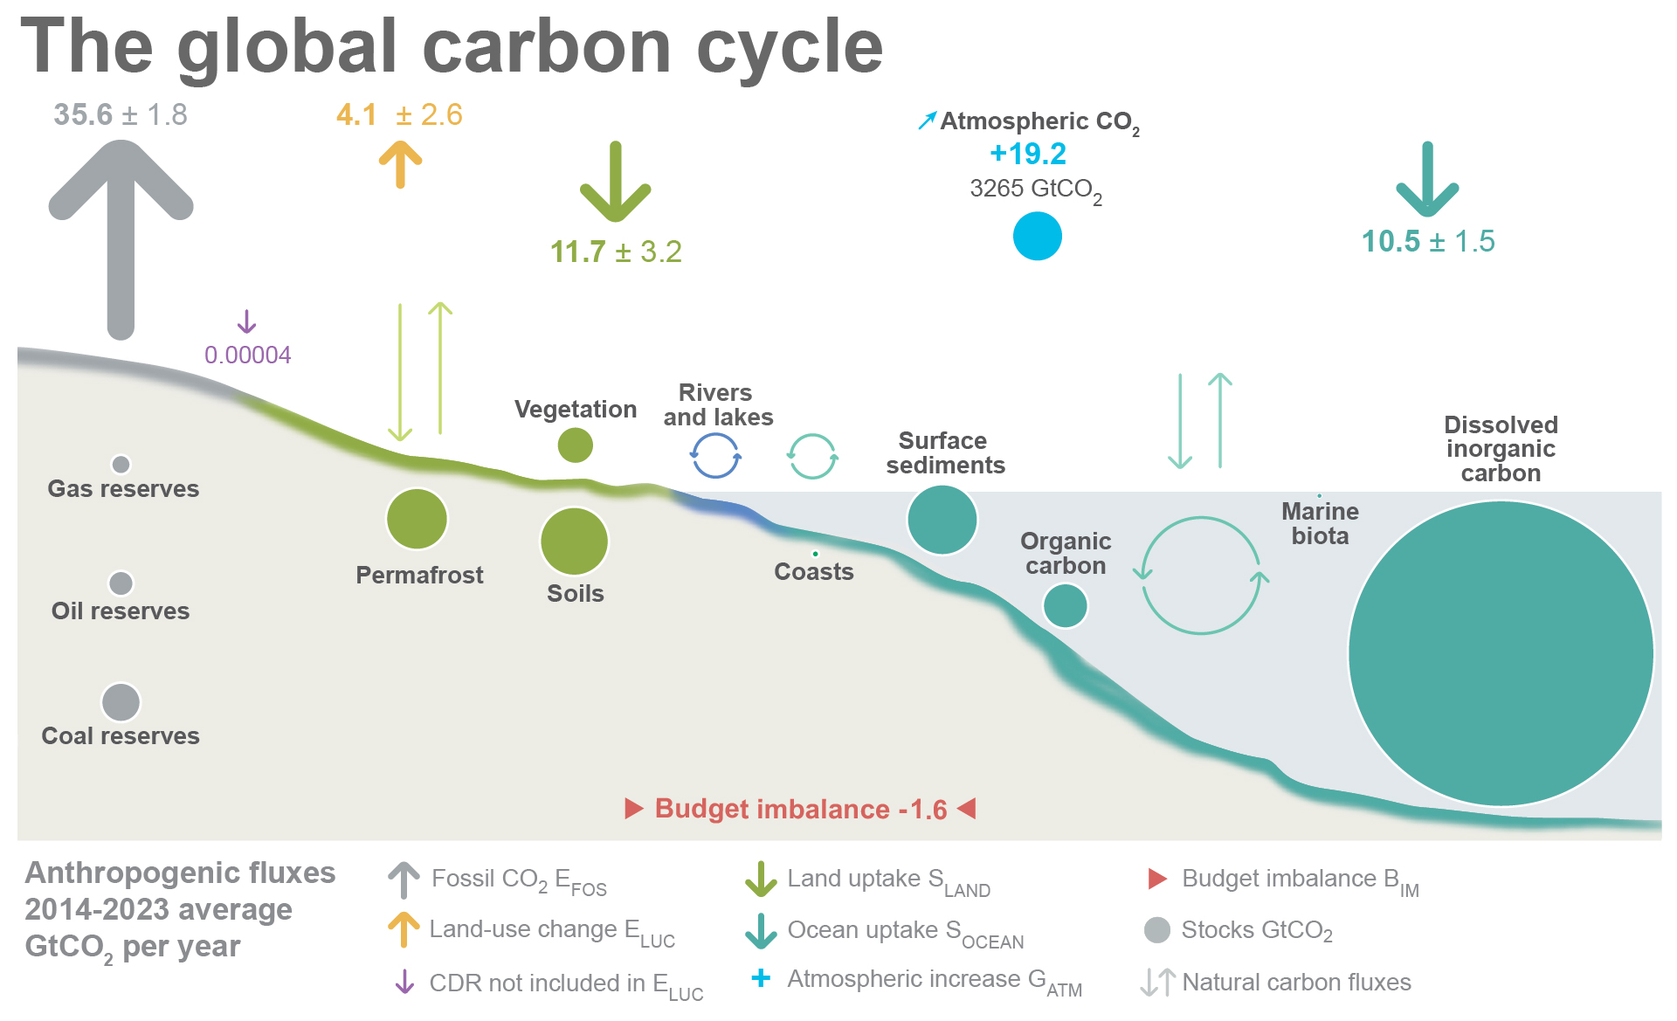

Slide 9
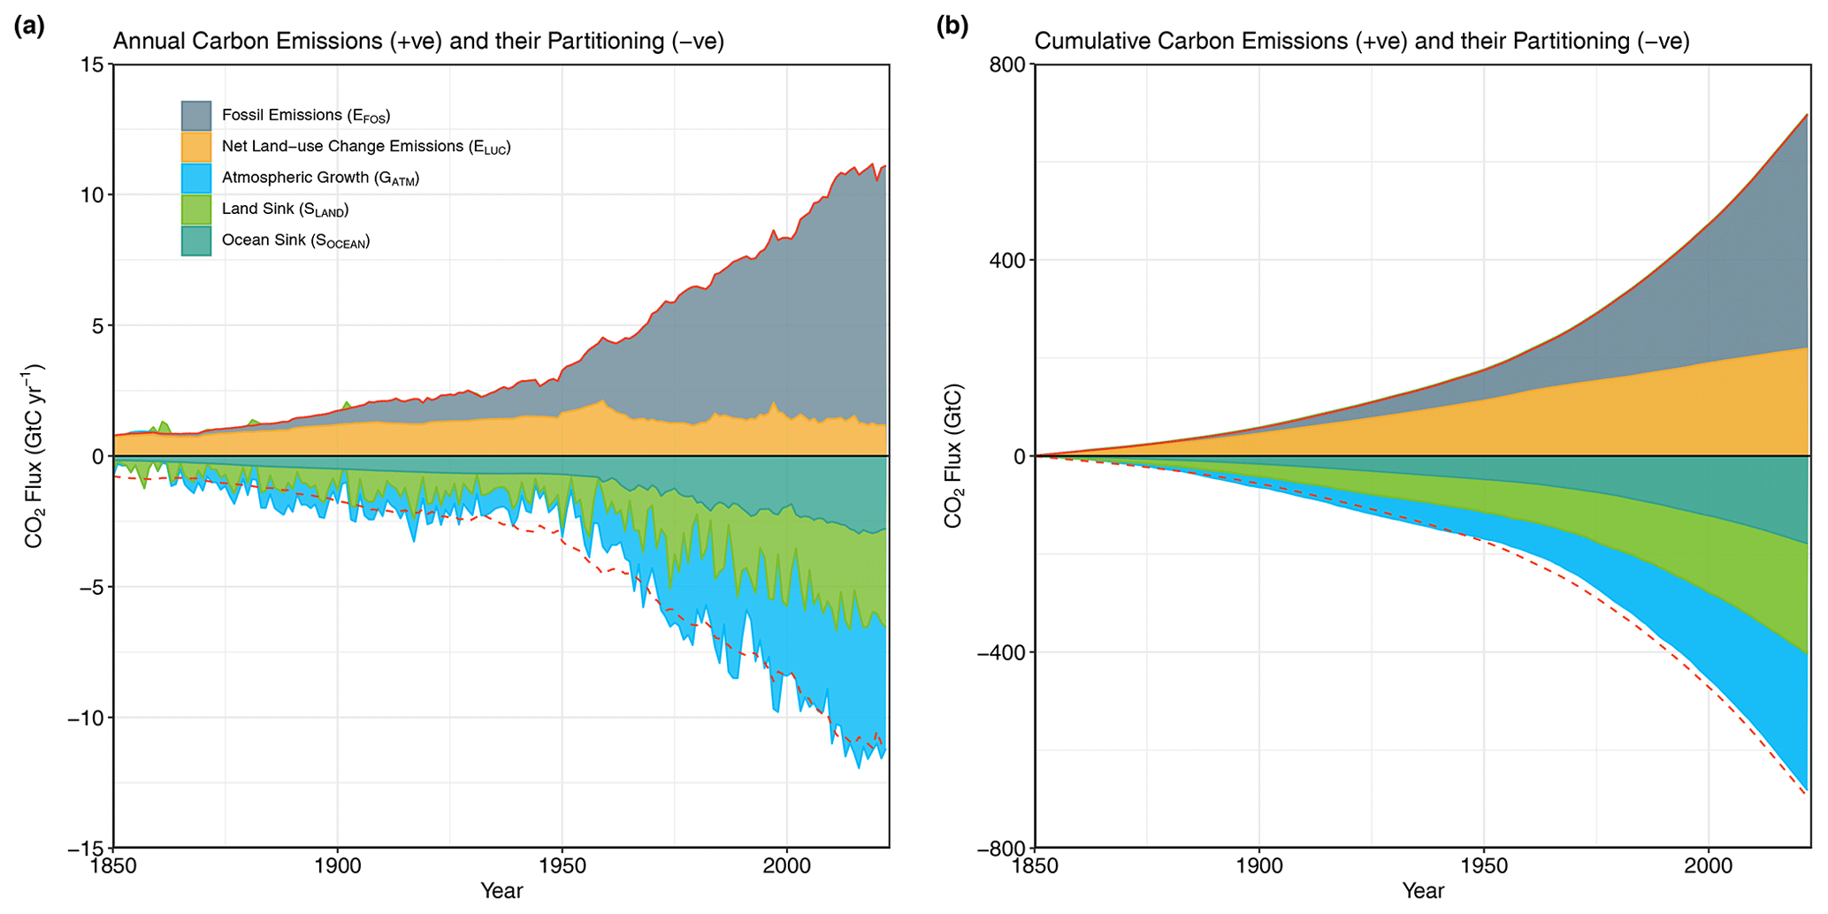

Slide 10
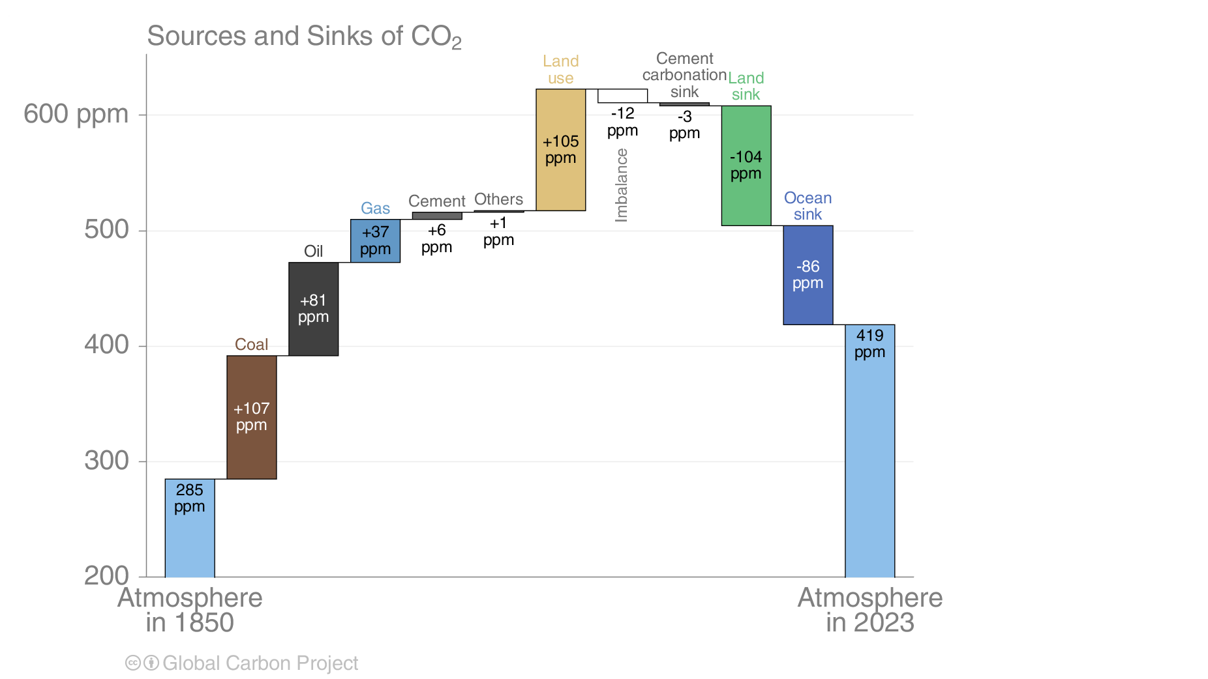

Slide 11
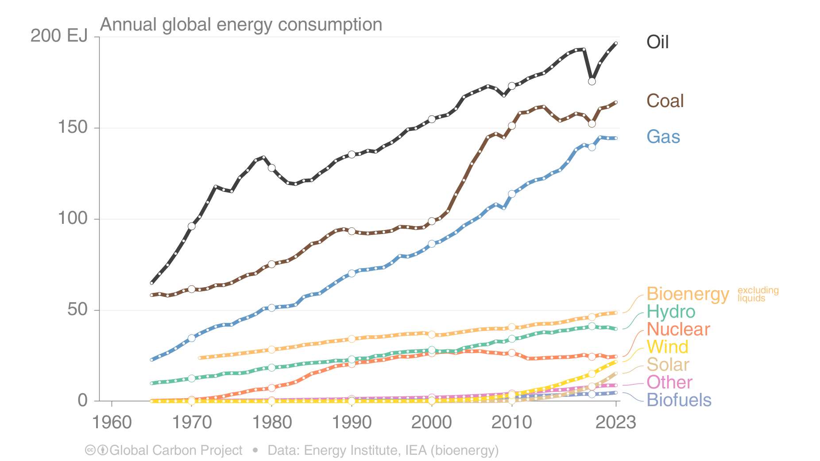
Fossil fuel emissions

Slide 12
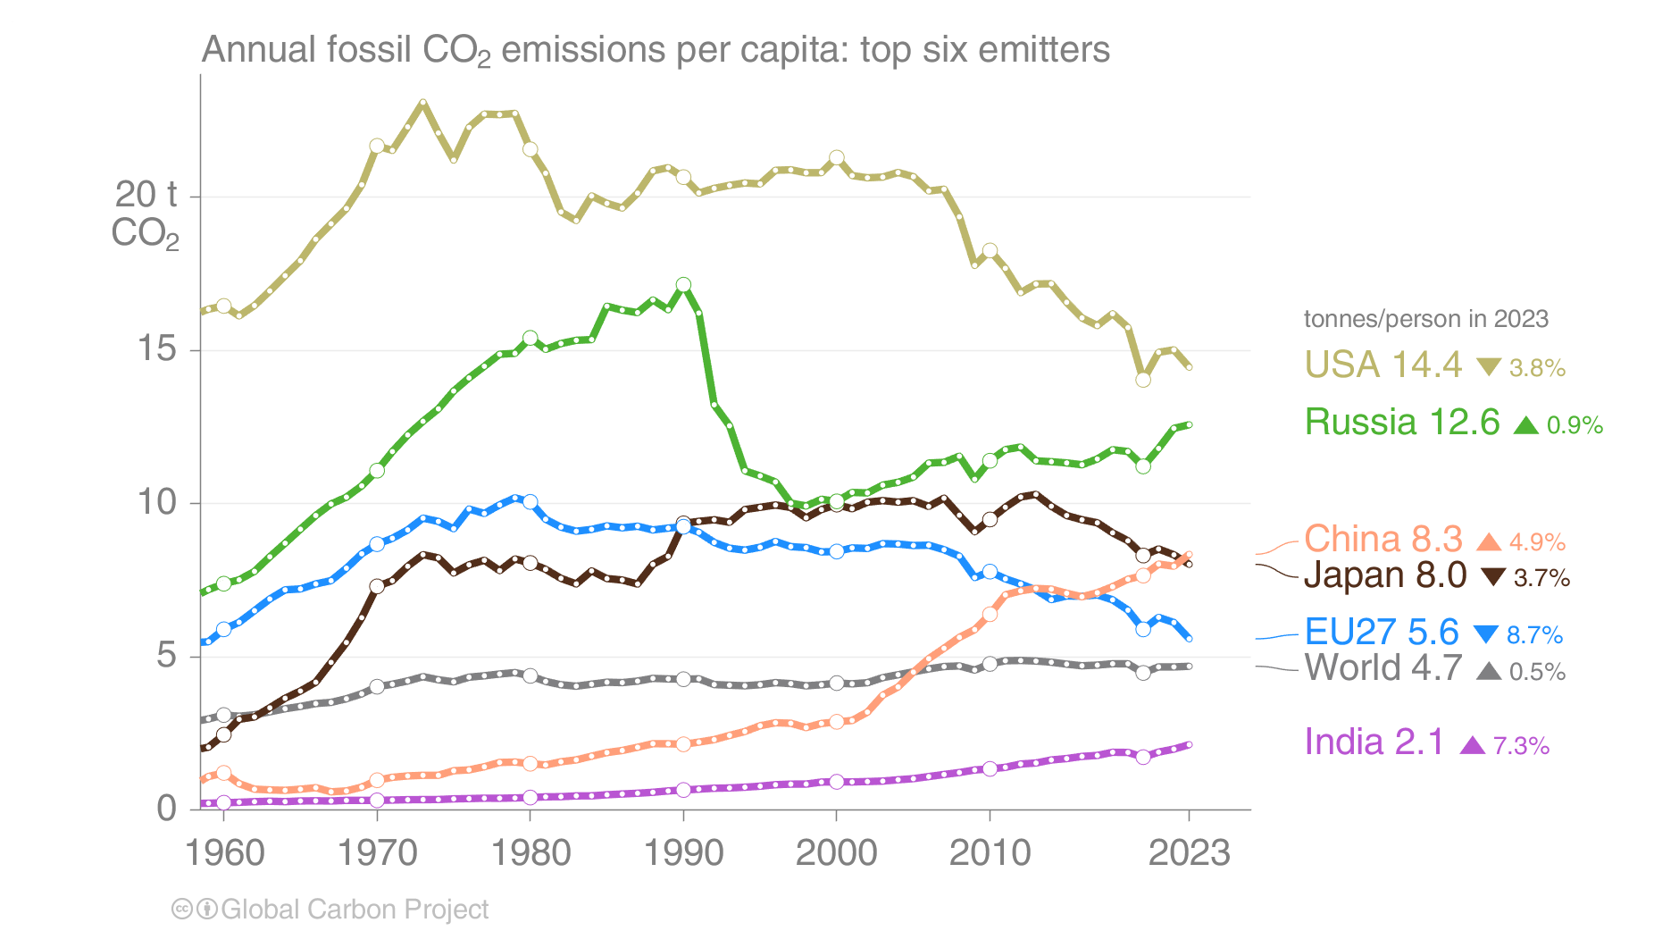
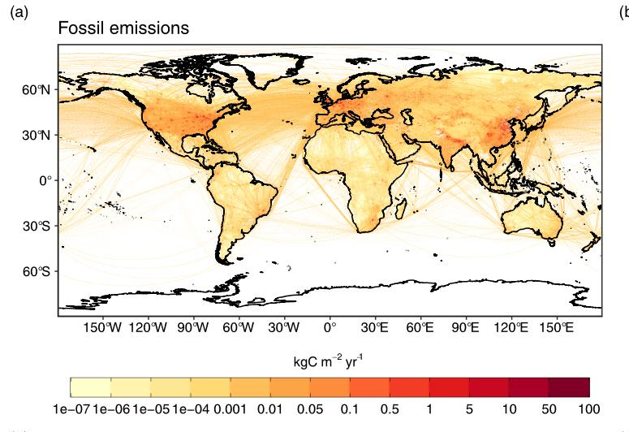
Fossil fuel emissions

Slide 14
Land use change emissions – what do we mean by that?

Slide 15
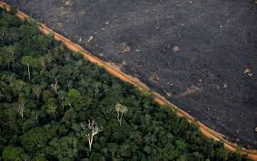
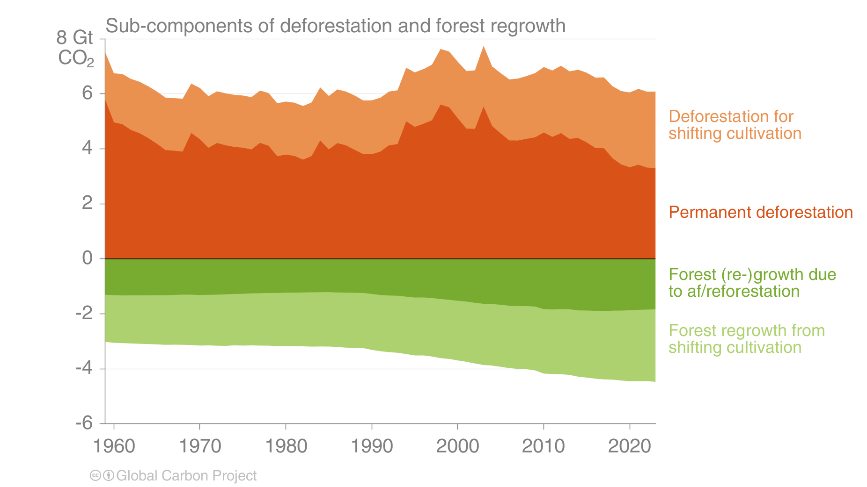
Land use change emissions

Slide 16
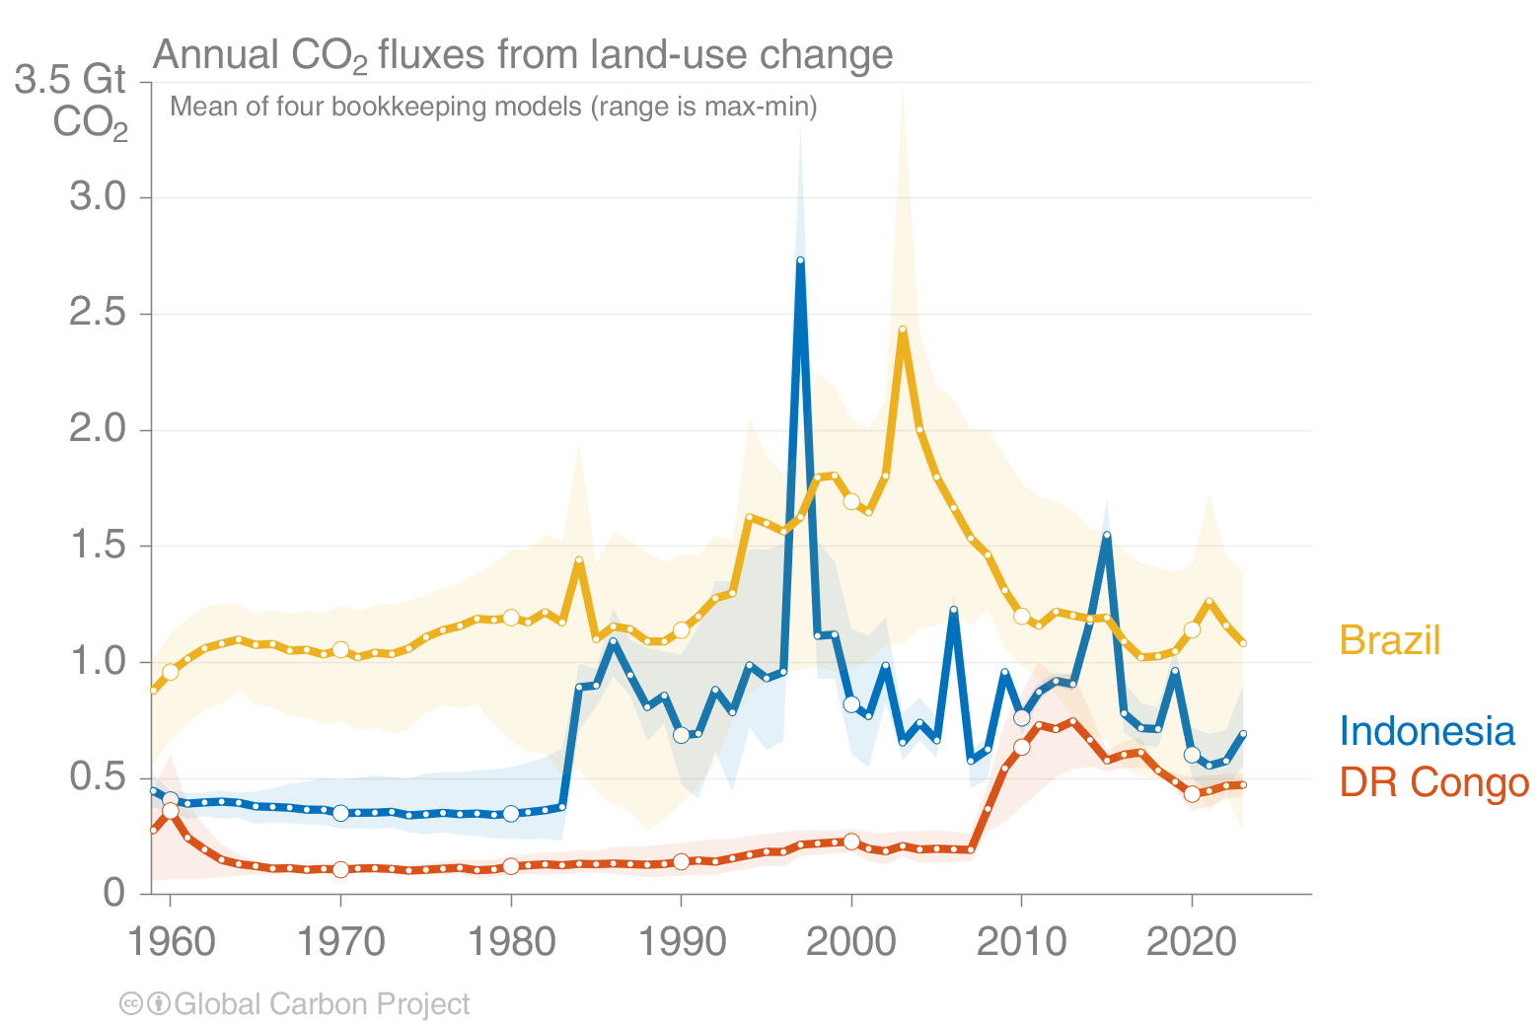
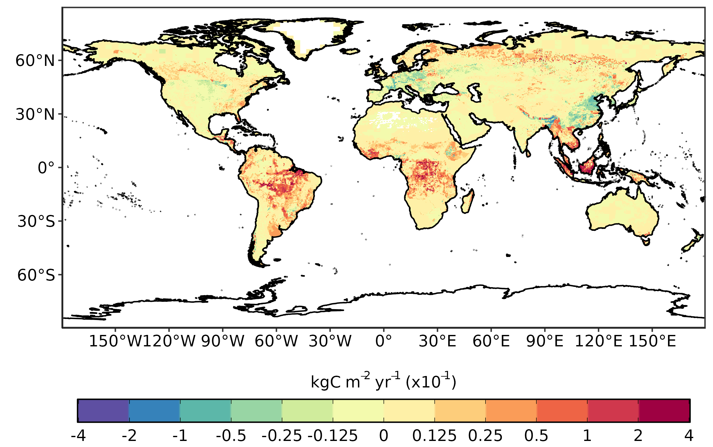
Land use change emissions

Slide 17
So how do these people know?
Lecture 14 – Observations and data in the Earth system

Slide 18
Emission inventories
National inventory
UN global inventory
National inventory
National inventory
IPCC guidelines
Transparent
Accurate
Consistent
National inventory

Slide 19
Emission inventories
Emission = emission factor x activity data
Amount of carbon released into the atmosphere by a specific process per unit time
How much of each process has taken place

Slide 20
Emission inventories – emission factors
Fossil fuels
C content of fuels
Industry
Chemical process
Land use
Changes in C stocks
Waste
C content in waste materials

Slide 21
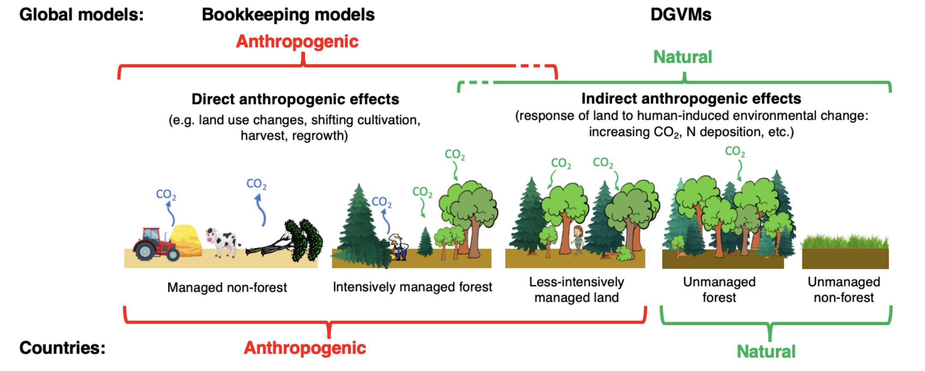
Emissions from LUC

Slide 23
Other greenhouse gases
Gas | Lifetime | GWP-20 | GWP-100 | GWP-500
CO₂ | Varies | 1 | 1 | 1
CH₄ | 11.8 ± 1.8 | 82.5 ± 25.8 | 29.8 ± 11 | 10.0 ± 3.8
N₂O | 109 ± 10 | 273 ± 118 | 273 ± 130 | 130 ± 64
IPCC AR6 WG1 Table 7.15

Slide 24
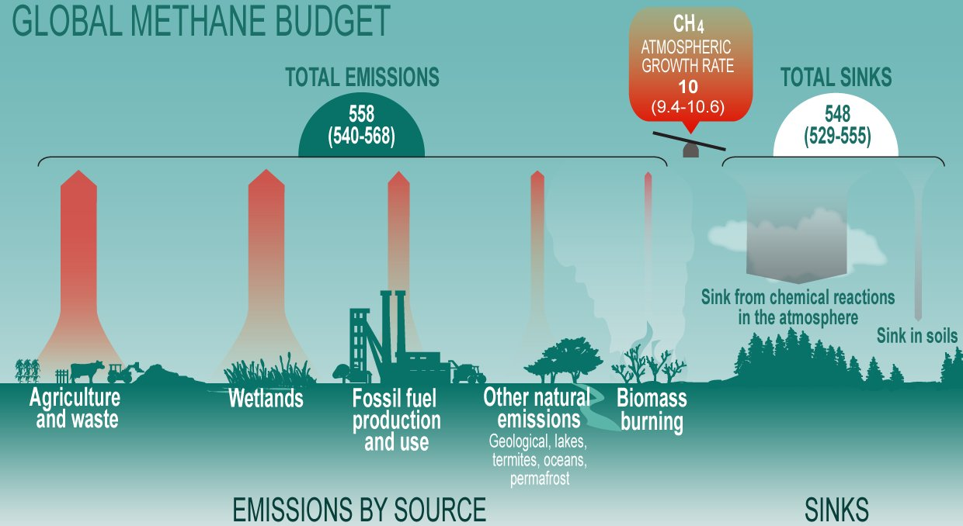
Methane
Gas | Lifetime | GWP-20 | GWP-100 | GWP-500
CO₂ | Varies | 1 | 1 | 1
CH₄ | 11.8 ± 1.8 | 82.5 ± 25.8 | 29.8 ± 11 | 10.0 ± 3.8
N₂O | 109 ± 10 | 273 ± 118 | 273 ± 130 | 130 ± 64

Slide 25
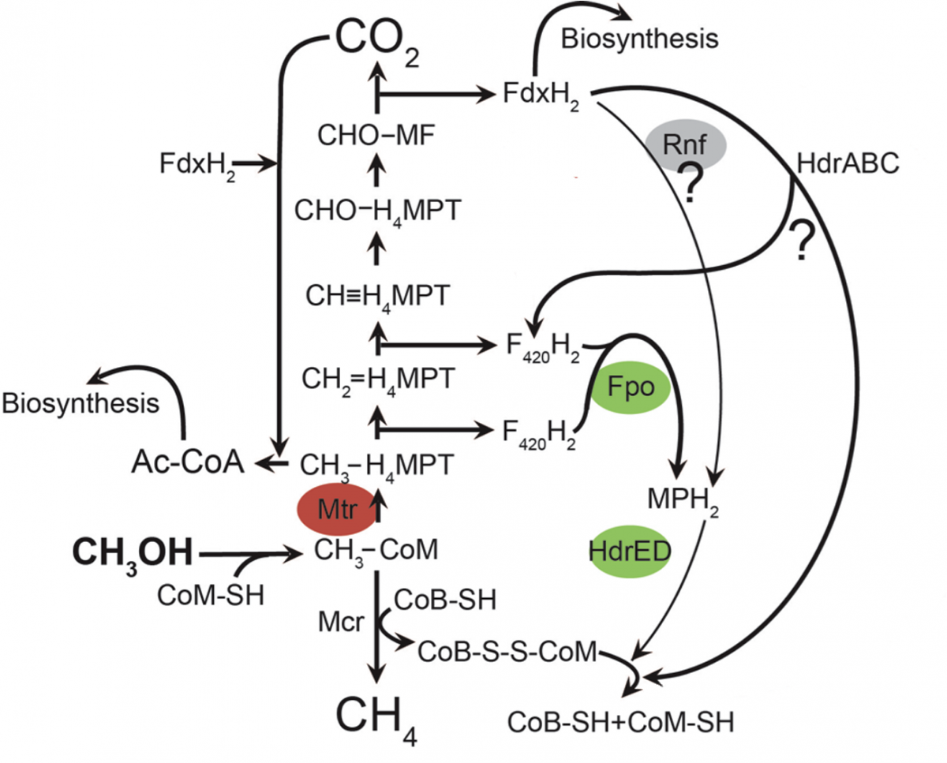
Sources: methanogenesis
A series of biochemical anaerobic reactions resulting in the production of methane

Slide 26
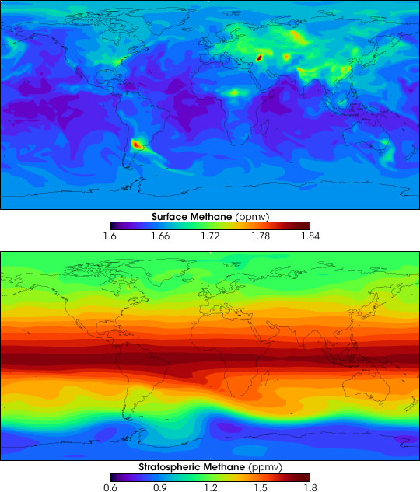
Sources: methanogenesis
Notes:
https://earthobservatory.nasa.gov/images/5270/atmospheric-methane

Slide 27
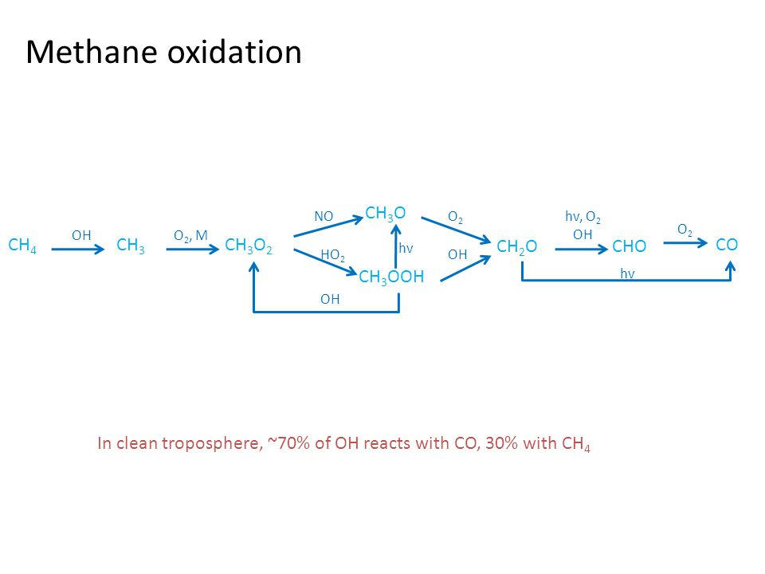
Atmospheric sink

Slide 28
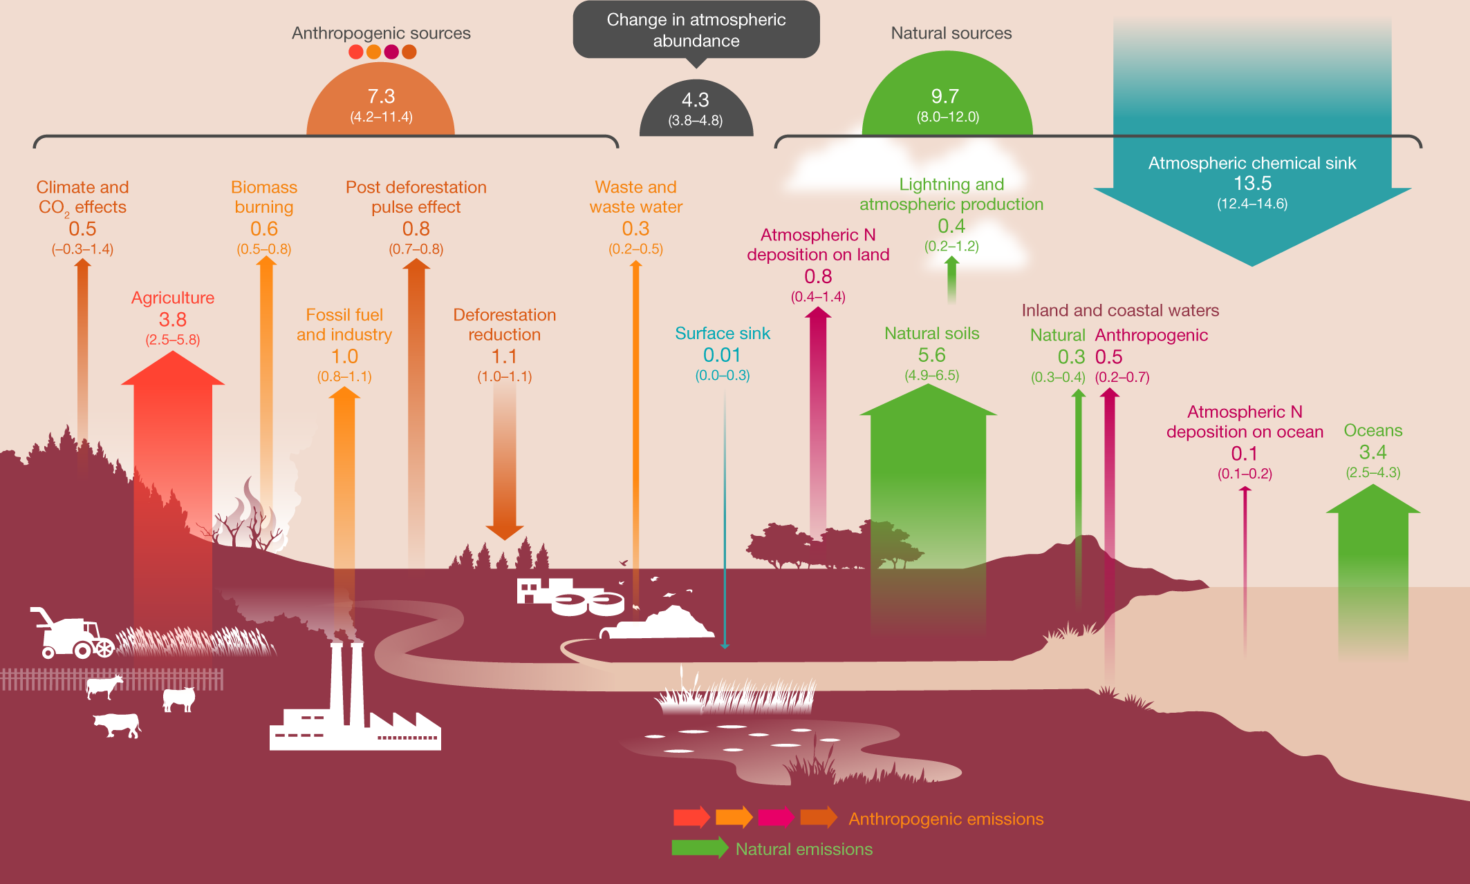
Nitrous oxide
Gas | Lifetime | GWP-20 | GWP-100 | GWP-500
CO₂ | Varies | 1 | 1 | 1
CH₄ | 11.8 ± 1.8 | 82.5 ± 25.8 | 29.8 ± 11 | 10.0 ± 3.8
N₂O | 109 ± 10 | 273 ± 118 | 273 ± 130 | 130 ± 64

Slide 29
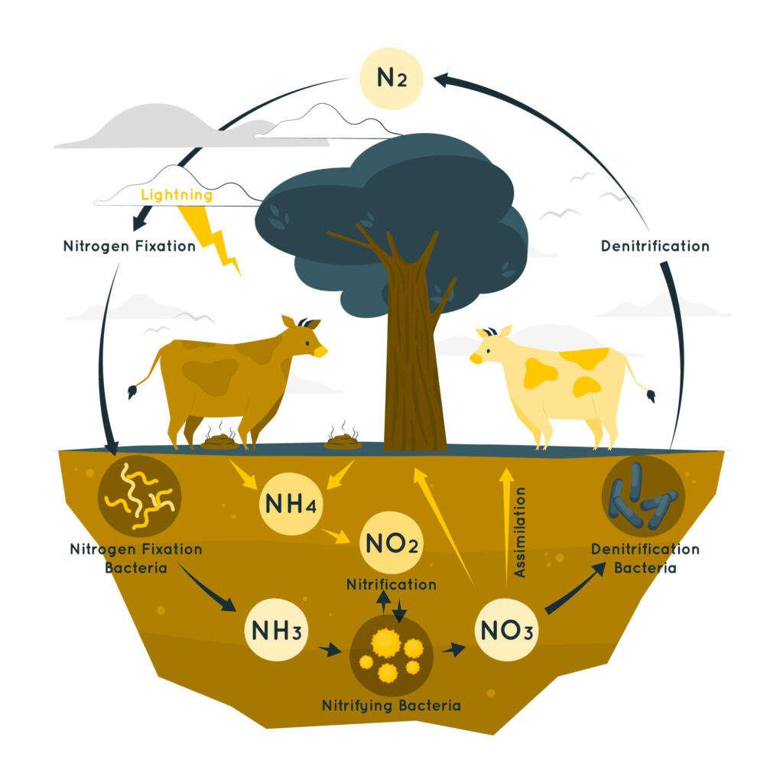
Sources of nitrous oxide

Slide 30

Atmospheric sink
Photolysis by UV radiation in the stratosphere

Slide 31
Global warming potential
Gas | Lifetime | GWP-20 | GWP-100 | GWP-500
CO₂ | Varies | 1 | 1 | 1
CH₄ | 11.8 ± 1.8 | 82.5 ± 25.8 | 29.8 ± 11 | 10.0 ± 3.8
N₂O | 109 ± 10 | 273 ± 118 | 273 ± 130 | 130 ± 64
IPCC AR6 WG1 Table 7.15

Slide 32
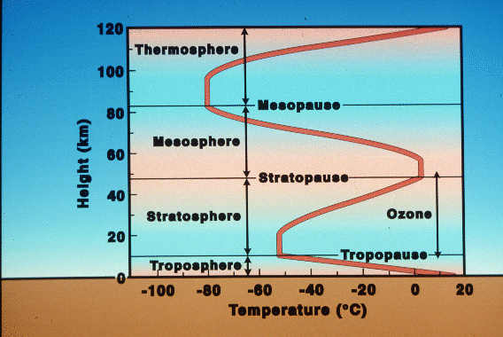
Tropopause
The troposphere is well mixed but transfer of compounds between the troposphere and stratosphere is much slower

Slide 34
Atmosphere
Climate fundamentals
Predicting climate
Atmosphere
Global C cycle
IPCC report
Earth system models
Climate impacts
Climate solutions
Extreme events
Tipping points
Sea ice, ice caps,
Energy
Mitigation
Nature-based solutions

